Slide 1
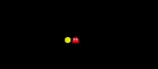
Cutscene Manager
Alex Morales Garcia
Notes:
En aquesta presentació parlarem de les Cutscene o Cinemàtiques.

Slide 2

Index
1.What is a Cutscene?
2.Why we use it?
3.Cutscene Systems
4.Cutscene Editors in Engines
5.Cutscene Manager

Slide 3
What is a Cutscene?
A sequence in a video game that is not interactive, breaking up the gameplay. -Wikipedia
A scene that develops the storyline and is often shown on completion of a certain level, or when the player's character dies. -Oxford Living dictionary
A scene in a videogame that may no be interactive, which usually develops the storyline and is shown when a certain event occurs.
Notes:
He agafat dues definicions, una de Wikipedia i l’altre d’Oxford Living dictionary. Com que ninguna de les dues m’acabava de convencer, he creat una a partir d’aquestes.
Primera: Diu que no es interactiu, però pot ser-ho.
Segona: Si, bé, però es pot generalitzar

Slide 4
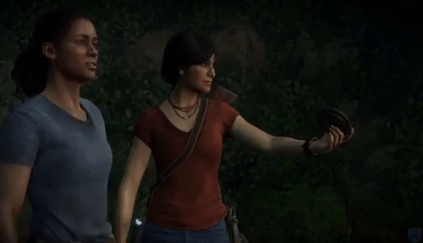

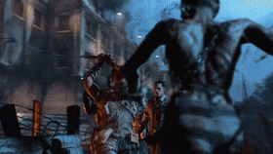

Why we use it?
History
Mood
Present
Gameplay
Notes:
Historia: Desenvolupar la historia. Explicar una mica aquell univers. Si hi ha dos bàndols, explicar la motivació dels primers, i perquè estan enfrontats entre ells.
Mood: Posar en un estat animic a aquell jugador. Volem transmetre una sensació al jugador. Si es un shooter, volem que el jugador es senti.
Presentar. Presentarli tots els elements que es troben, el nou escenari.

Slide 5
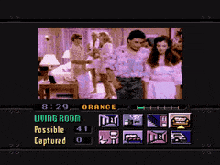
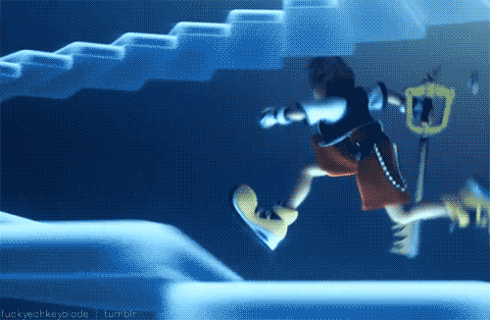
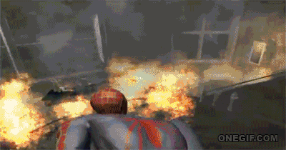
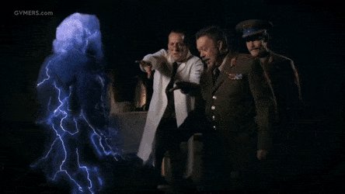

Cutscenes Systems
Live-action
Pre-rendered
In-Game
Interactive
Mixed media

Slide 6
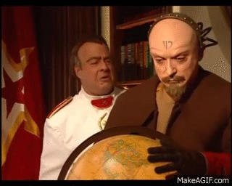
Live-Action
Involves real actors on a set or in front of a chroma screen

Slide 7
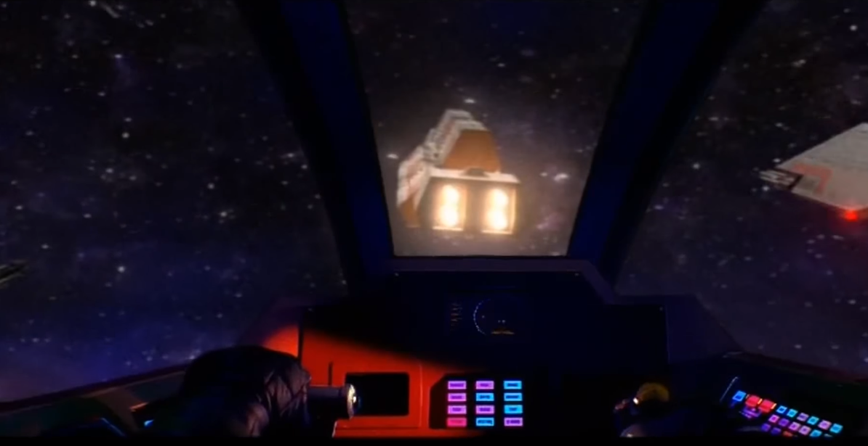
Mixed media
The game uses both pre-rendered and real time cutscenes or combine techniques.

Slide 8
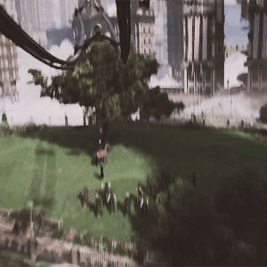

Pre-rendered
Animated and rendered beforehand

Slide 9
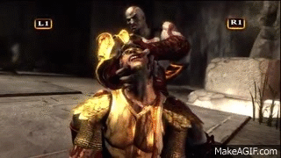
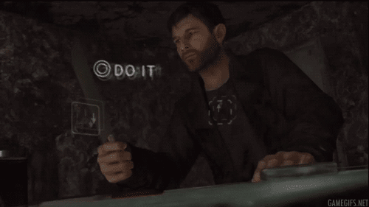
Interactive
Involves the player taking control of the character in certain moments.

Slide 10
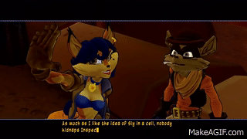
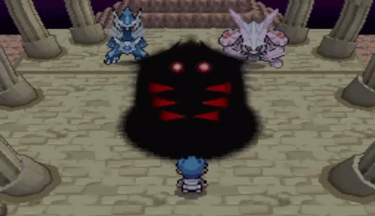
In-Game
The system is using the games graphics engine to render the cutscene.
Notes:
Advantages: Feedback del player. Si s’utilitza el motor per renderitzar escenes, no es necesita integrar un altre equip especialitzat.
Disadvantages: Pitjor qualitat, pero avui dia no hi ha molta diferencia.

Slide 11
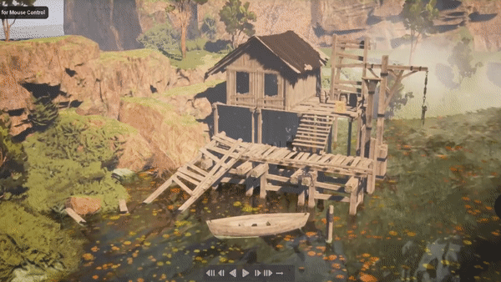
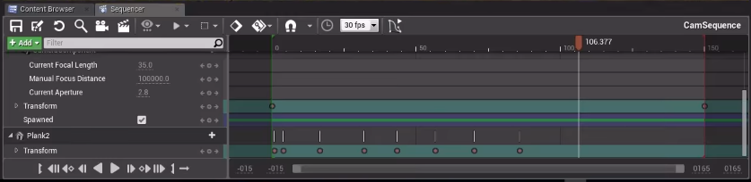
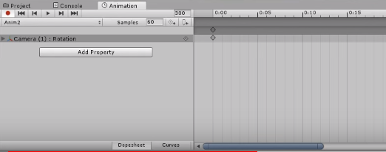
Cutscene Manager in Engines

Slide 12
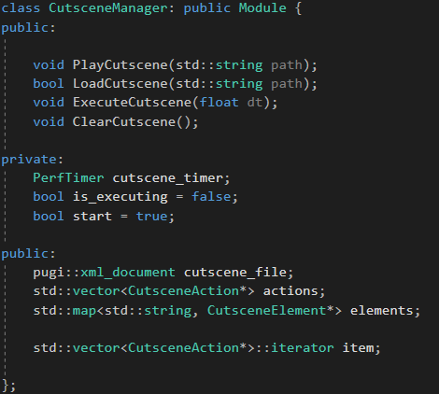
Cutscene Manager
Main functions:
void PlayCutscene(string path)
void LoadCutscene(string path)
void ExecuteCutscene(float dt)
void ClearCutscene();

Slide 13
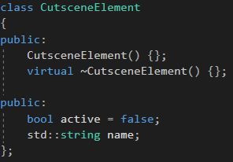
Cutscene Elements
Elements that appear in the cutscene. There are four types:
Map
Entity
Text
Image

Slide 14
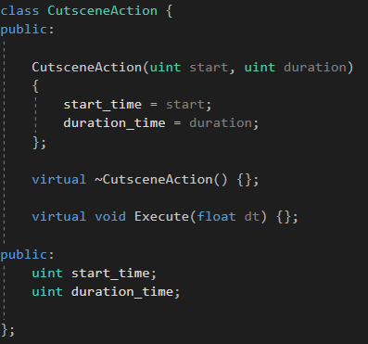
Cutscene Actions
Actions that will reproduce in the cutscene. There are four different types:
MoveCamera
MoveEntity
ModifyText
ModifyImage

Slide 15
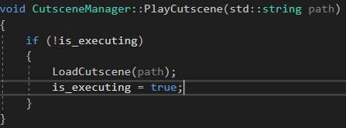
PlayCutscene
Call LoadCutscene and set the parameter is_executing to true.
It needs the xml path.

Slide 16

LoadCutscene
ExecuteCutscene
ClearCutscene
It loads all the elements from the xml. It receives a path which is the location of the xml document.
Iterates the elements of the actions. When the action is finished, it goes to the next one.
Clears all the elements and actions from the actions and elements.

Slide 17
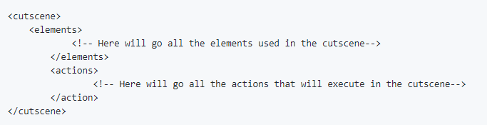
XML
The XML has a cutscene child. Inside of it there is the elements and the actions:

Slide 18
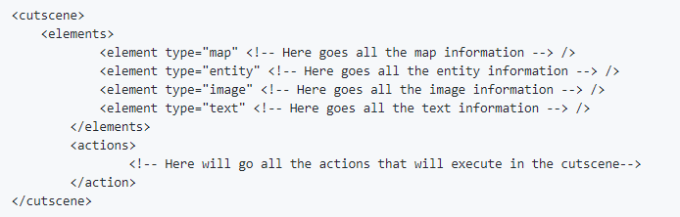
XML Elements
<element type=”” <!--Info about that element--> />

Slide 19
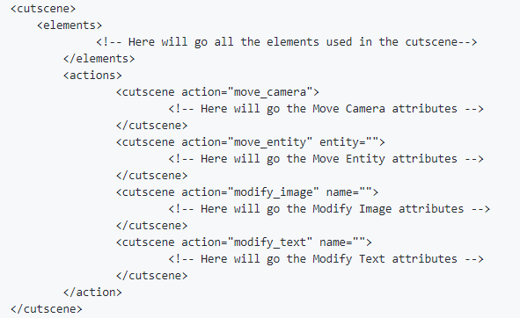
XML Actions
<cutscene action=””>
<!--Action attribute-->
</cutscene>

Slide 20

TODO 1
Add 3 CutsceneEntity:
Gold: His name is gold, and it has to be situated in x=10 and y=340.
Silver: Her name is silver, and it has to be situated in x=670 and y=338.
Ruby: His name is rival, and it has to be situated in x=670 and y=365.
Tip:
<element type="" name="" pos_x="" pos_y=""/>

Slide 21

TODO 2
Add a CutsceneImage, which will be used as a dialog.
The name has to be dialog_image.
The position is {85,265} and the rect {0,0,370,103}.
It has to be deactivated when starts.
Tip:
<element type="" name ="" pos_x="" pos_y="" rect_x="" rect_y="" rect_w="" rect_h="" active=""/>

Slide 22

TODO 3
Create a MoveEntity action. You have to pass:
the name of the entity which will be affected by it. We want that gold is affected by it.
start time = 0
duration = 4000
speed_x = 88
speed y = 0.
Tip:
<cutscene action="" entity="">
<time start="" duration="" speed_x="" speed_y=""/>
</cutscene>

Slide 23
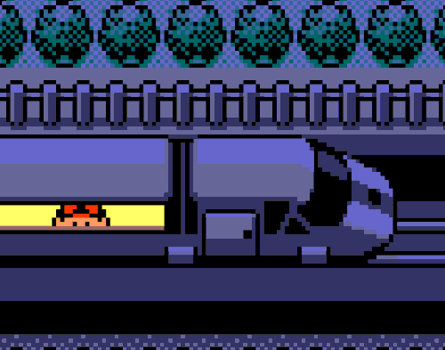
TODO 4
Create a new CutsceneEntity which will be load from the xml.
Check the CutsceneEntity constructor for more information.

Slide 24
TODO 5
Create a new CutsceneImage which will be load from the xml.
Check the CutsceneImage constructor for more information.

Slide 25
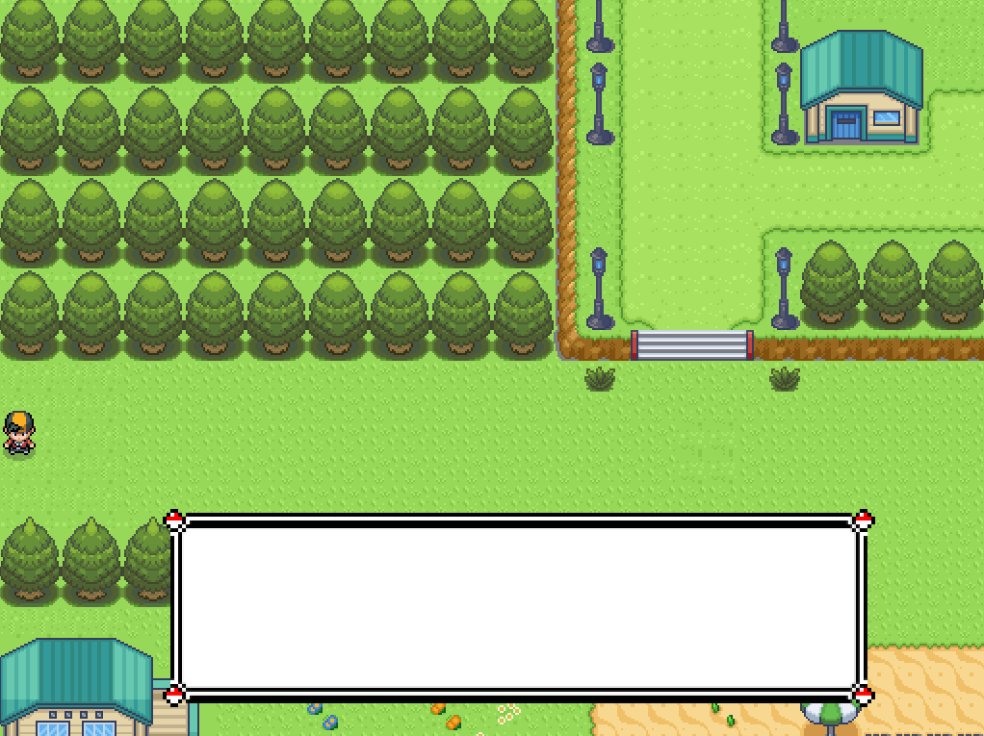
You should see this

Slide 26

TODO 6
Create a new CutsceneMoveEntity that will be load from the xml.
Check the CutsceneMoveEntity constructor for more information.

Slide 27

TODO 7: Just one more!
Find the corresponding entity depending on the entity_name that has been passed.
All the elements are in a map, which first value is a string and a second one is a CutsceneElement.
There is a function in maps which is find(). You have to find it by the name and acces to the second element.

Slide 28
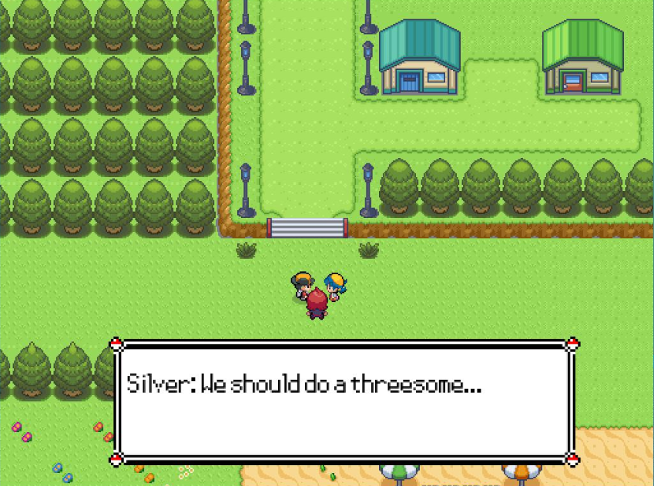
TODO 8: The last one! Yeah, finally! Thank you :)
Uncomment the code and check functionallity. The result has to be something like this:

Slide 29

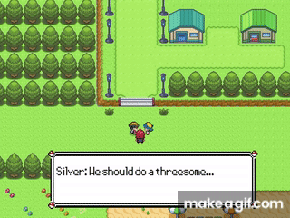
Thank you for your attention!
GitHub: AlexMG99
Gmail: alex2521999@gmail.com
Twitter, Instagram and everything: alex2521999

